Slide 1
ENERGY transfers and transformations
YEAR 9 SCIENCE
2025

Slide 2
LEARNING INTENTIONS
Classify energy types.
Identify and describe energy transformations.
Describe the 1st Law of Thermodynamics (Law of Conservation of Energy).
Understand how energy can be transferred and/or transformed using simple scenarios.

Slide 3
WHAT IS ENERGY?

Slide 4
DEFINITION OF ENERGY
( in 3 sentences )
Work involves applying a
movement across a
object that causes
to do work.
in units called
Energy is defined as
joules (J).
force on an
the capacity
distance. Energy is measured
Energy is defined as the capacity to do work. Work involves applying a force on an object that causes movement across a distance. Energy is measured in units called joules (J).

Slide 5
FORMS OF ENERGY
NUCLEAR
HEAT/thermal
CHEMICAL
SOUND/acoustic
There are five energy forms missing…
Can you remember any of these?
Notes:
light, kinetic, elastic potential, electrical

Slide 6
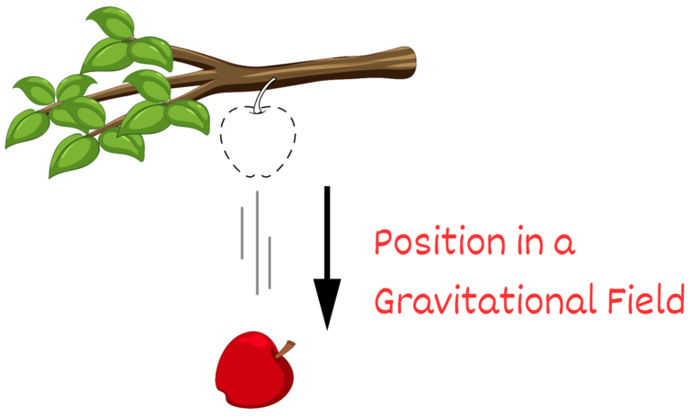
GRAVITATIONAL POTENTIAL ENERGY
The energy due to position in a gravitational field
E_{P} = mass x acceleration due to gravity x height
E_{P} = mgh
Q: What is the E_{P} of a 200g apple that is on a branch 5m above the ground?

Slide 7
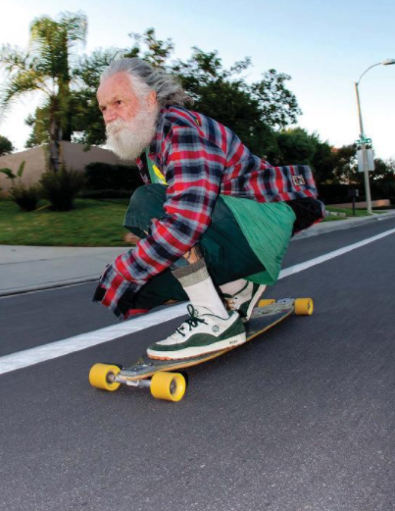
KINETIC ENERGY
The energy of movement.
E_{k} = ½ x mass x velocity²
E_{k} = ½ mv²
Q: What is the E_{K}of a skateboarder with a mass of 75kg who is travelling at 15 kmh⁻¹?

Slide 8
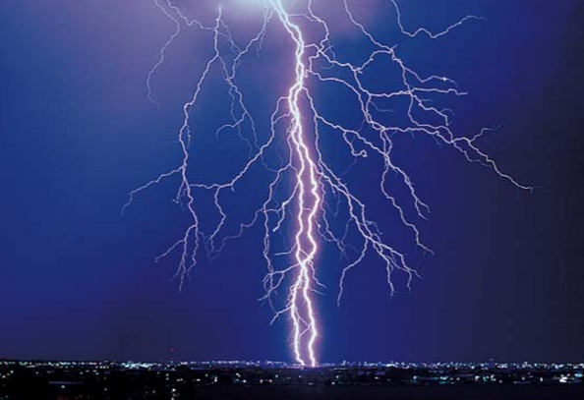
ELECTRICAL ENERGY
The energy of electrons which are flowing.

Slide 9
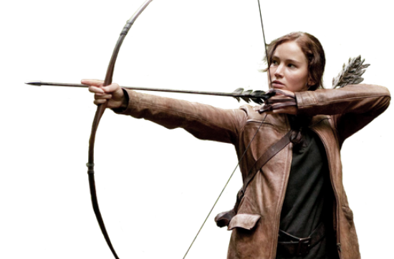
ELASTIC POTENTIAL ENERGY
The energy stored when an object is stretched or compressed
(also known as stored elastic energy)

Slide 10

LIGHT ENERGY
The energy given out by LUMINOUS OBJECTS.
e.g. light bulbs, the sun, fire

Slide 11
2 MAIN GROUPS
– KINETIC & POTENTIAL ENERGY
Kinetic Energy – involves particles moving | Potential Energy – any energy that can be stored
kinetic | gravitational
heat | chemical
light | elastic
electrical | nuclear
sound

Slide 12
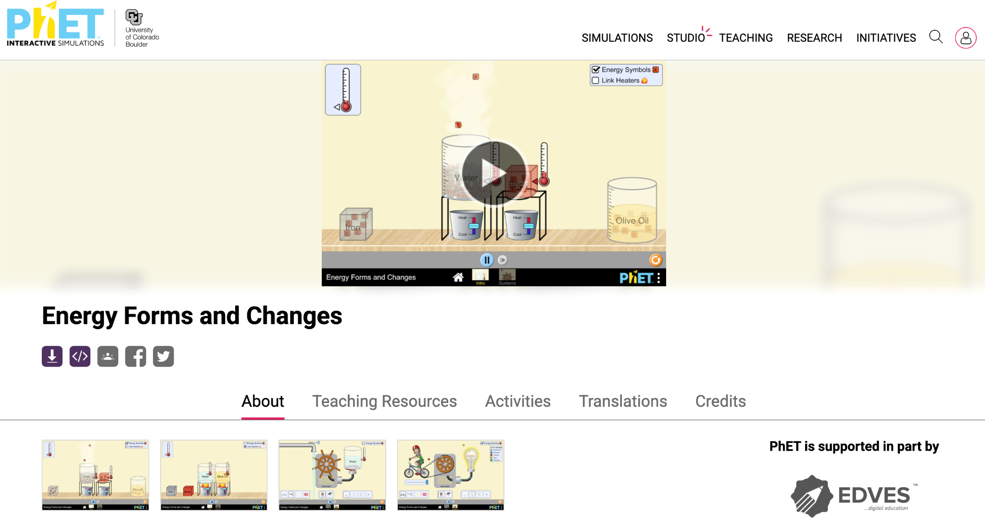
Activity: Energy forms and changes
Use the PhET Simulation - Energy Forms and Changes to complete the interactive activity.

Slide 13
SOURCE OF ENERGY?

Slide 14
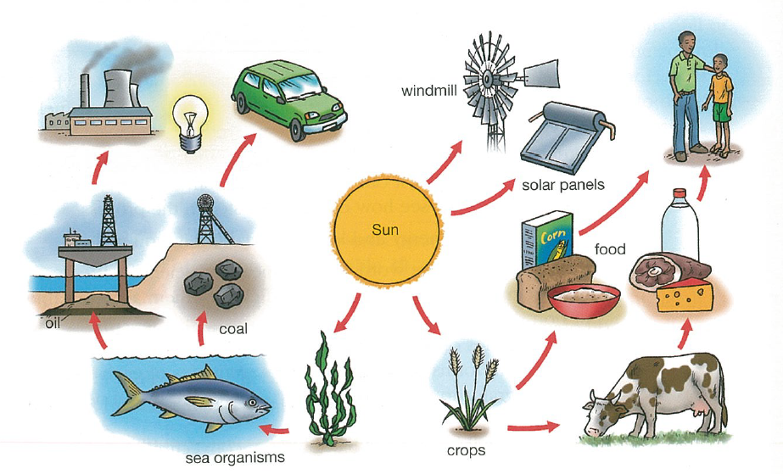
SOURCES OF ENERGY
“…the sun is the original source of most energy on Earth.”
Explain how this is true using driving a car (which uses petrol) as an example.
Cars run on oil (petrol)
Oil is made from millions of dead plants and animals (from thousands of years ago).
Plants get their energy from the sun.
Animals get their energy from plants (or other animals).

Slide 15
1ST LAW OF THERMODYNAMICS & ENERGY TRANSFORMATIONS

Slide 16
THE 1ST LAW OF THERMODYNAMICS
= The Law of Conservation of Energy
“The total amount of energy in the universe is constant. Energy cannot be created or destroyed, it can only change place or form.”

Slide 17
THE 1ST LAW OF THERMODYNAMICS
This could be written like this:
Student in class:
Chemical energy (food) → kinetic energy + heat energy + sound energy
We call these ENERGY TRANSFORMATIONS.
For the following slides,
What is the energy going in, what is the energy changing/transforming into?

Slide 18

Electrical energy
→ kinetic energy
(+ heat energy
+ sound energy)

Slide 19
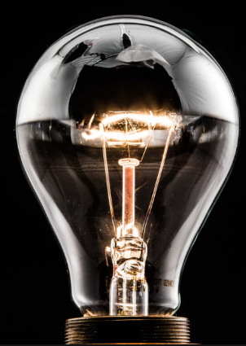
Electrical energy → light energy (+ heat energy)

Slide 20

(kinetic energy) → Elastic potential energy → kinetic energy
(+ heat energy + sound energy)

Slide 21
NOW YOUR TURN!
For the following energy changes,
Think of a new object or situation which has this energy change.
e.g.
Q: CHEMICAL ENERGY → HEAT ENERGY
A: You!

Slide 22
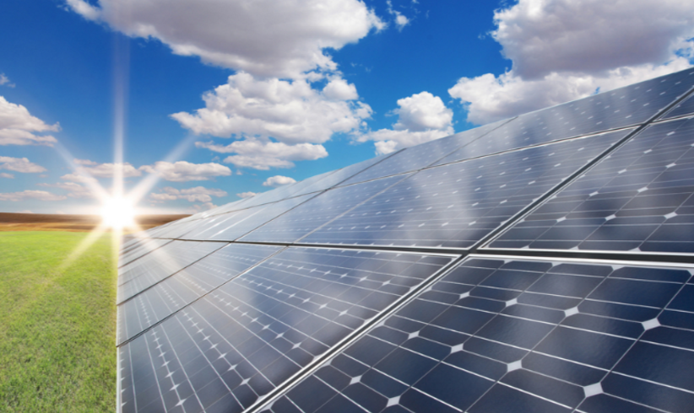
Light energy → electrical energy

Slide 23

Chemical energy → Kinetic energy → gravitational potential energy

Slide 24

Light energy → chemical energy

Slide 25
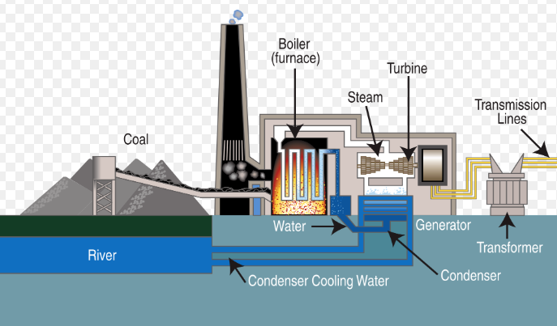
Chemical energy → heat energy → kinetic energy → electrical energy

Slide 26

Chemical energy → electrical energy → sound + light energy

Slide 27
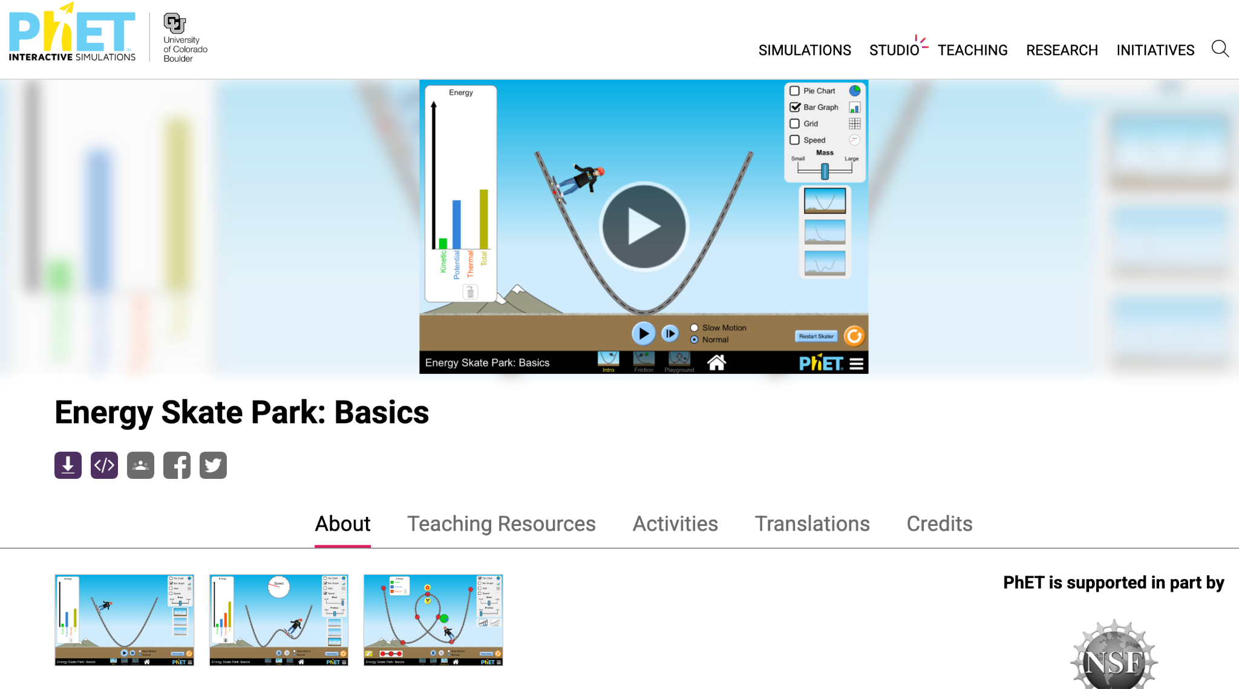
Activity: Skate Park Basics
Use the PhET Simulation - Skate Park Basics to complete the interactive activity.

